Slide 1


ComicDB
Michael Cummins
CS 377
https://github.com/michaelcummins1/CS377Final

Slide 2

Why Comic Books?
I collect comic books
Good fit for various database relationships
One to Many: Publisher to Issues, Publisher to Series, Story Arc to Issues, Creator to Character
Many to Many: Creator to Issues, Characters to Issues

Slide 3

Database Schema
publisher
PK: publisher_id
series
PK: series_id
FK: publisher_id → publisher(publisher_id)
creator
PK: creator_id
issue
PK: issue_id
FK: series_id → series(series_id)
character
PK: character_id
FK: publisher_id → publisher(publisher_id)
story_arc
PK: arc_id
FK: publisher_id → publisher(publisher_id)
issue_creator (bridge table)
PK: (issue_id, creator_id, role) — composite
FK: issue_id → issue(issue_id)
FK: creator_id → creator(creator_id)
issue_character (bridge table)
PK: (issue_id, character_id) — composite
FK: issue_id → issue(issue_id)
FK: character_id → character(character_id)
issue_story_arc (bridge table)
PK: (issue_id, arc_id) — composite
FK: issue_id → issue(issue_id)
FK: arc_id → story_arc(arc_id)

Slide 4

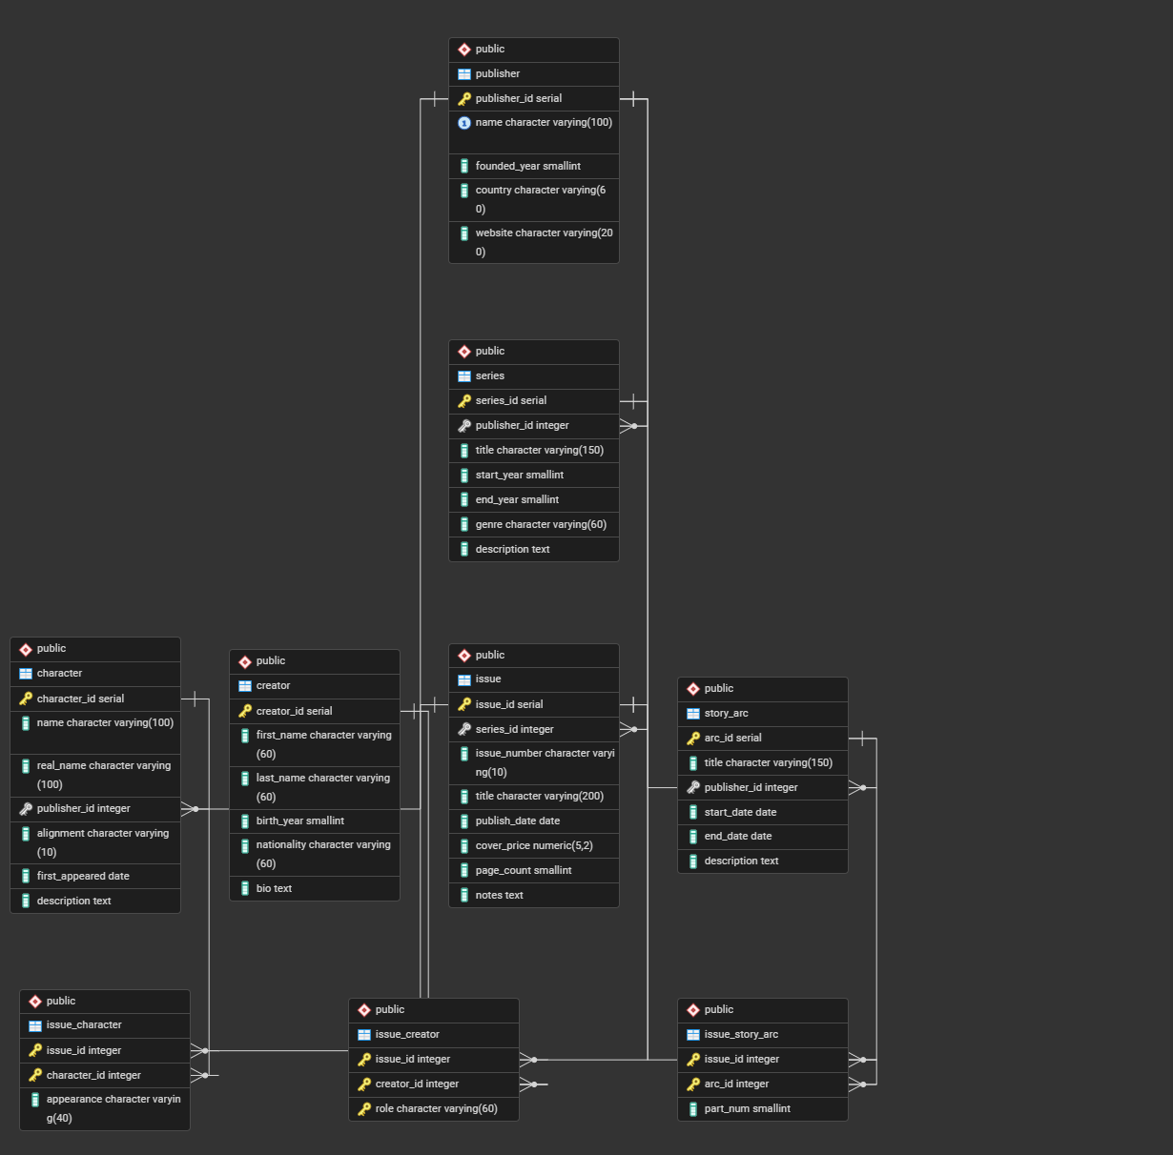
ERD Diagram

Slide 5

Procedures and Functions Overview
Functions (called with SELECT * FROM ...)
get_issues_by_publisher — Returns all issues for a given publisher (New Feature - LOWER())
get_creator_credits — Returns all issues a creator worked on and their role (New Feature - LOWER())
search_characters_by_name — Searches characters by partial name with string analysis (New Feature - LOWER())
get_story_arc_issues — Returns all issues in a story arc with creator credits (New Feature - LOWER())
summarize_publisher_stats — Statistical overview of every publisher with grand total (New Feature - ROUND())
get_issues_with_character_count — Returns issues featuring at least N characters
get_creator_string_analysis — String function breakdown on creator last names (New Feature - LOWER())
get_issue_rankings — Ranks issues by cover price within each series using window functions
get_genre_cross_publisher — Shows which publishers cover which genres
Procedures (called with CALL ...)
add_issue — Inserts a new issue into an existing series (New Feature - RAISE EXCEPTION/NOTICE)
update_series_end_year — Marks an ongoing series as ended (New Feature - RAISE EXCEPTION/NOTICE and LOWER())
delete_creator_credits — Removes all credits for a given creator (New Feature - GET DIAGNOSTICS)
transfer_series_to_publisher — Bulk moves all series from one publisher to another (New Feature - RAISE EXCEPTION/NOTICE)
Views (called with SELECT * FROM ...)
v_publisher_series_summary — Reusable view of series and issue counts per publisher
v_character_appearance_summary — Reusable view of total appearances per character

Slide 6
Key Query Walkthrough
CREATE OR REPLACE FUNCTION get_genre_cross_publisher()
RETURNS TABLE (
publisher VARCHAR,
genre VARCHAR,
series_count BIGINT
)
LANGUAGE plpgsql AS $$
BEGIN
RETURN QUERY
SELECT
p.name AS publisher,
genre_list.genre,
COUNT(s.series_id) AS series_count
FROM publisher p
CROSS JOIN (
SELECT DISTINCT s2.genre
FROM series s2
WHERE s2.genre IS NOT NULL
) AS genre_list
LEFT JOIN series s
ON s.publisher_id = p.publisher_id
AND s.genre = genre_list.genre
GROUP BY p.name, genre_list.genre
HAVING COUNT(s.series_id) > 0
ORDER BY p.name, series_count DESC;
END;
$$;
get_genre_cross_publisher
Cross Join selects every unique genre that exists in the series table and pairs every publisher with every genre, whether or not it actually exists
Left Join matches each pair to an existing series in the database (keeps it if it exists, marks it NULL if it does not exist)
Then counts how many exist, groups by publisher and count descending

Slide 7
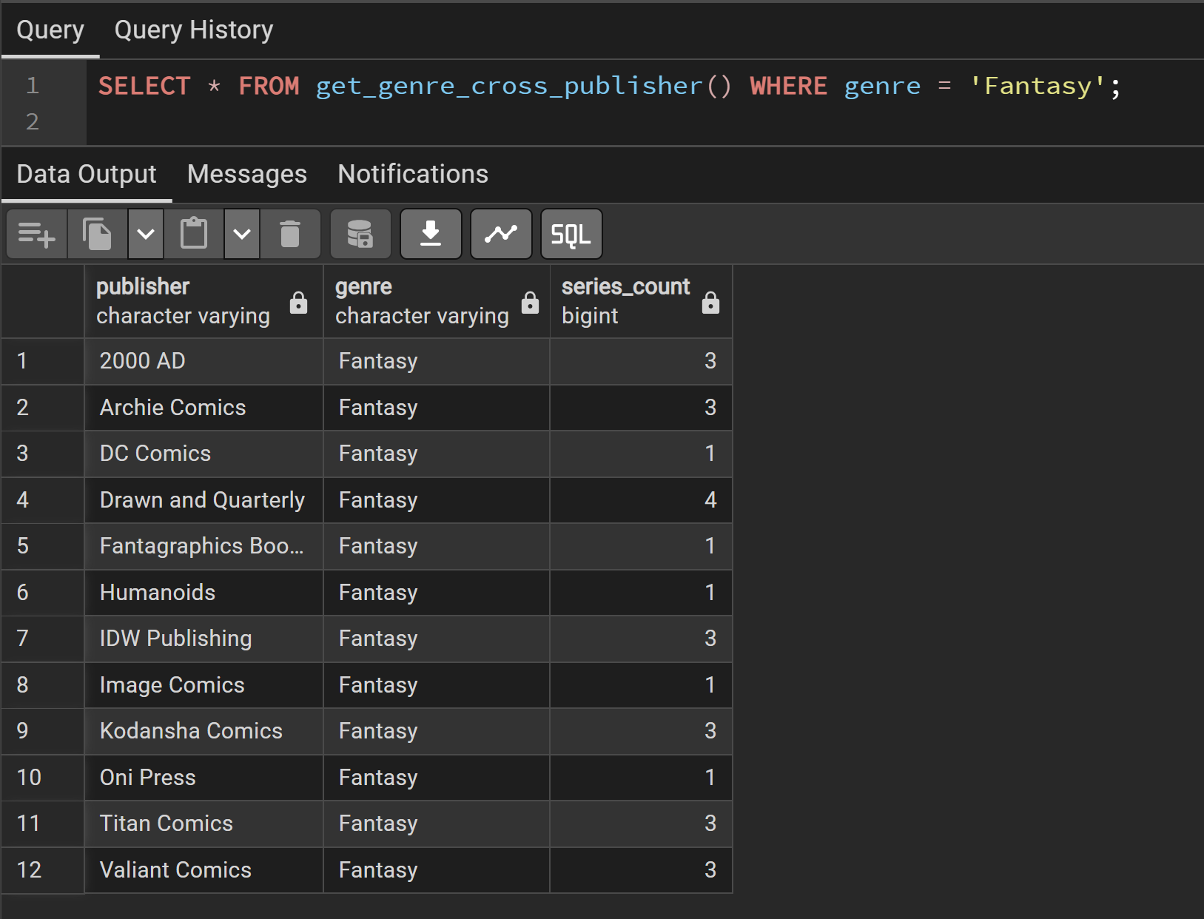

Key Query Walkthrough
get_genre_cross_publisher

Slide 8
Challenges and Takeaways
Gathering Data
Table Configurations
SMALLINT Casting difficulties (update_series_end_year)
Pre-planning is extremely important
Good table structure = simpler queries
The more saved procedures, functions, and views the better

Slide 9
Thank you!

